Slide 1
Citrix Roaming Session
Users guide for Citrix Roaming Sessions

Slide 2

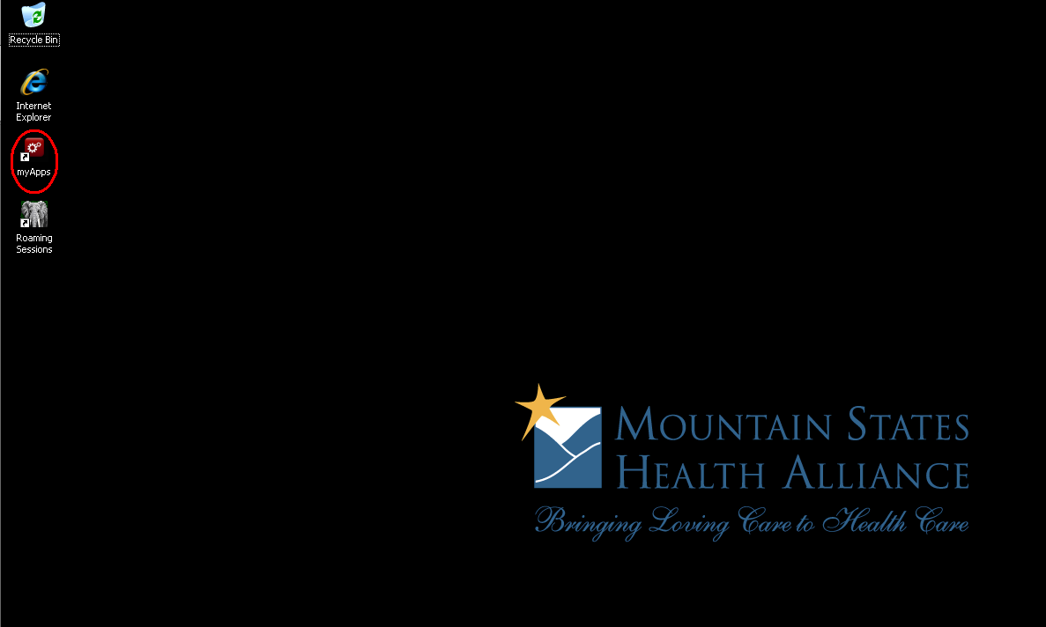
On the Desktop you will see the myApps Icon
*Double Click the myApps Icon*
my APPS Icon

Slide 3
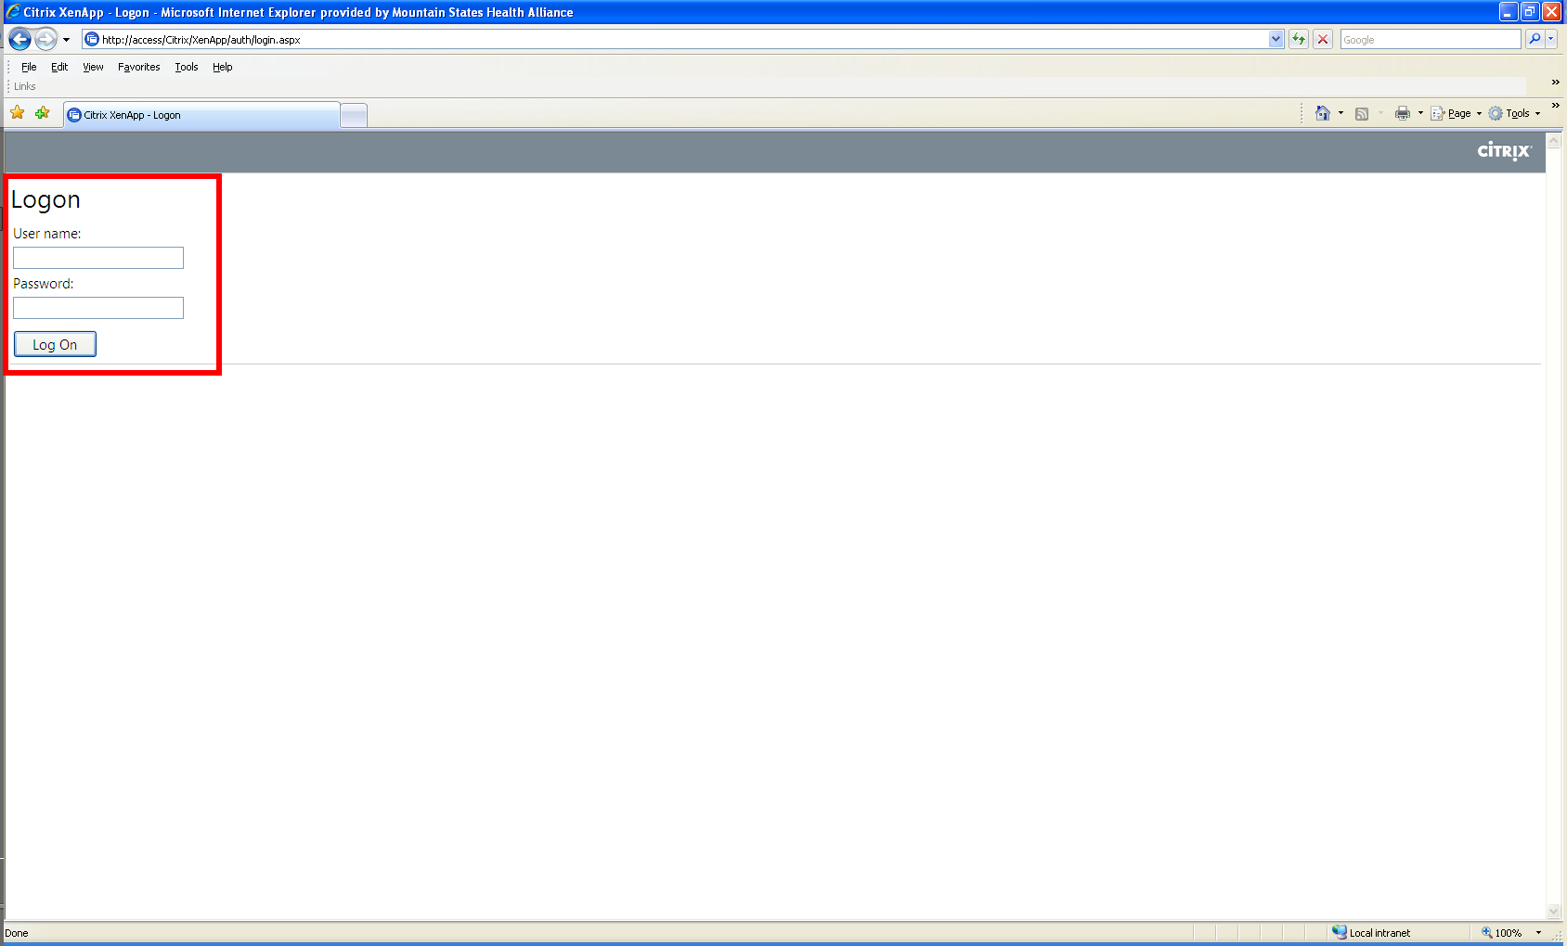
The Network Login page will display
*Username & Password are required*

Slide 4

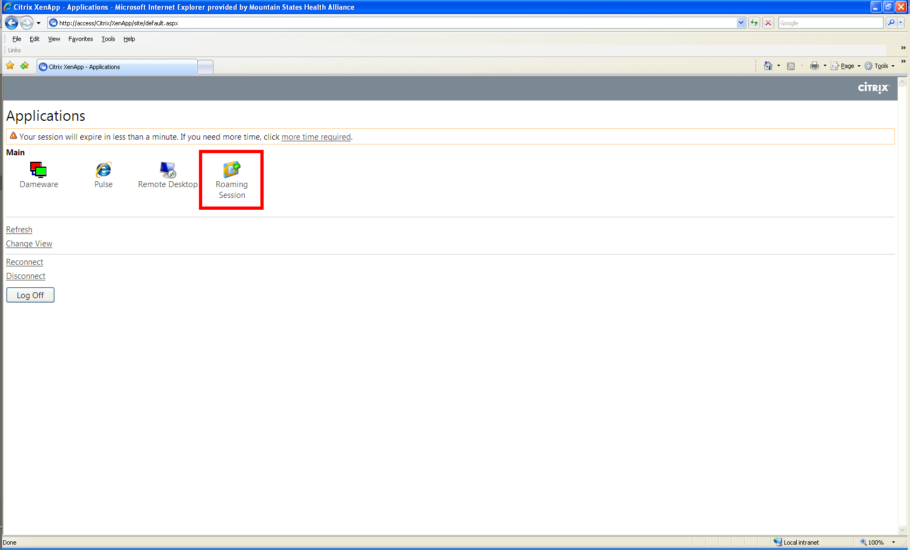
Single Click on the Roaming Session Icon

Slide 5
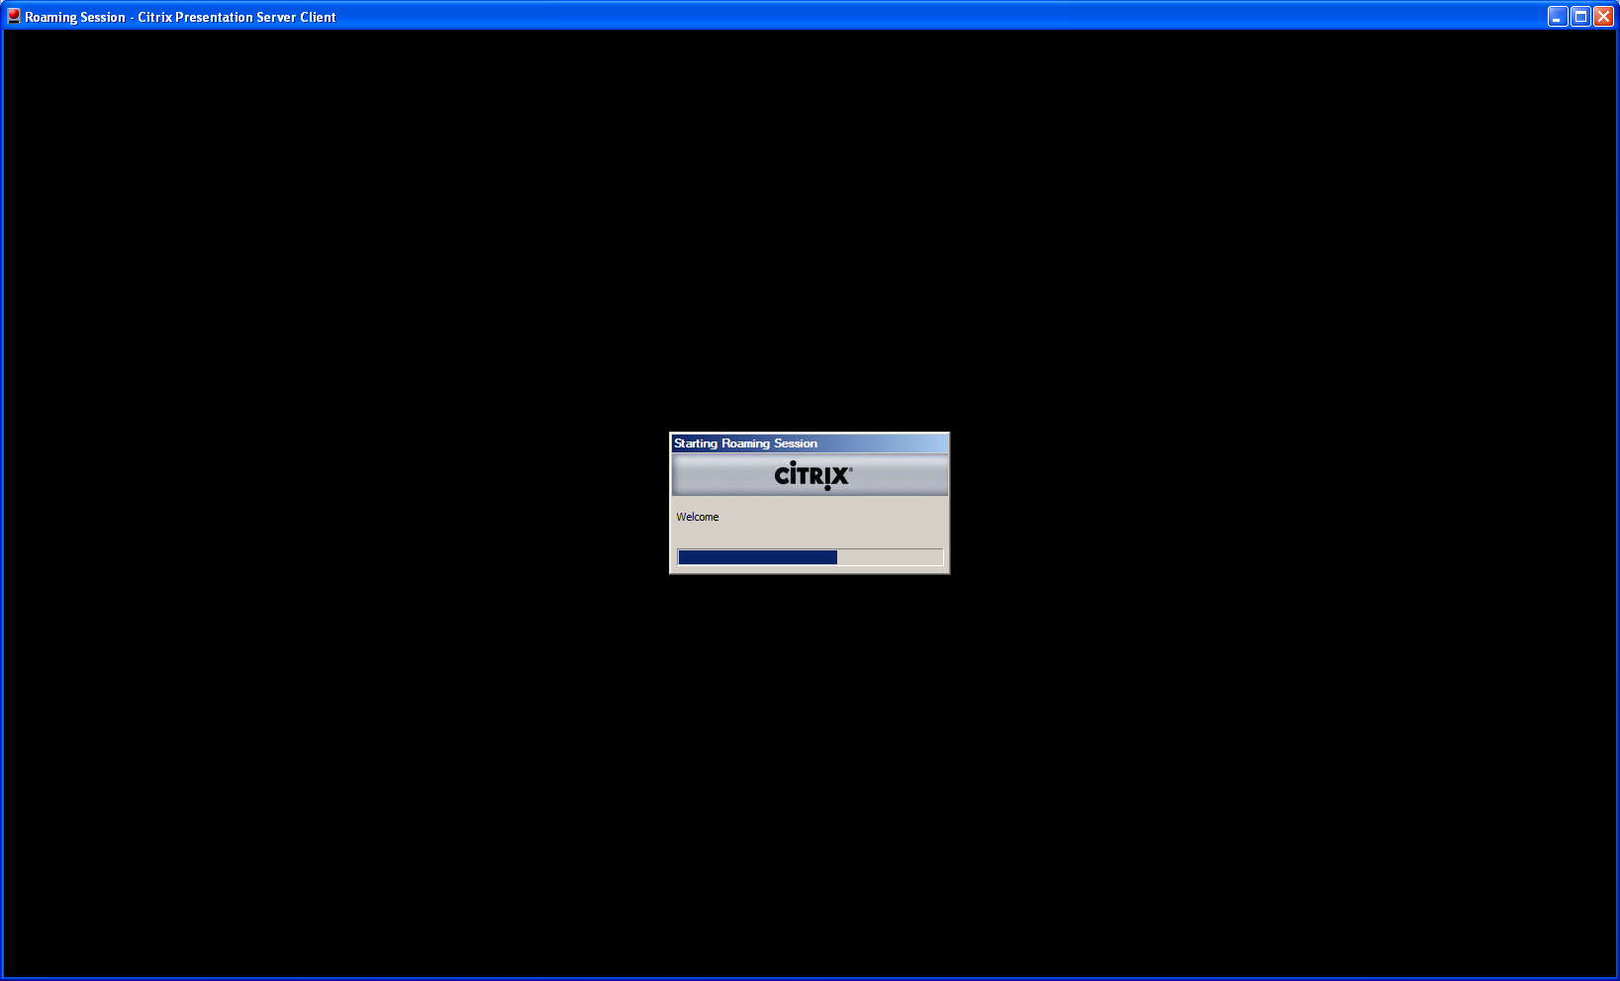
Your Citrix Roaming Session will begin loading

Slide 6
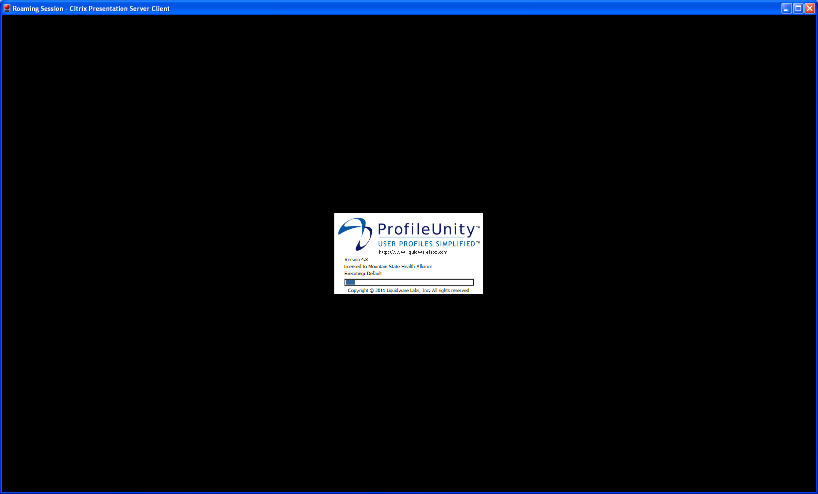
When your Citrix Roaming Session is loading it will also load your User Profile

Slide 7

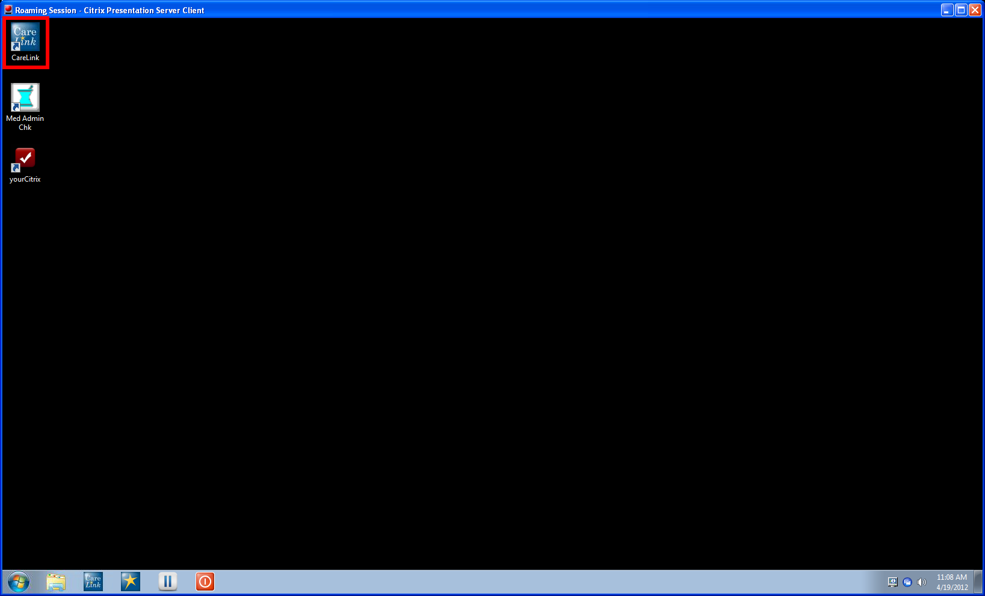
Your Roaming Session will load and there will be a CareLink Icon on the desktop. Double click the CareLink Icon to load your Dashboard

Slide 8
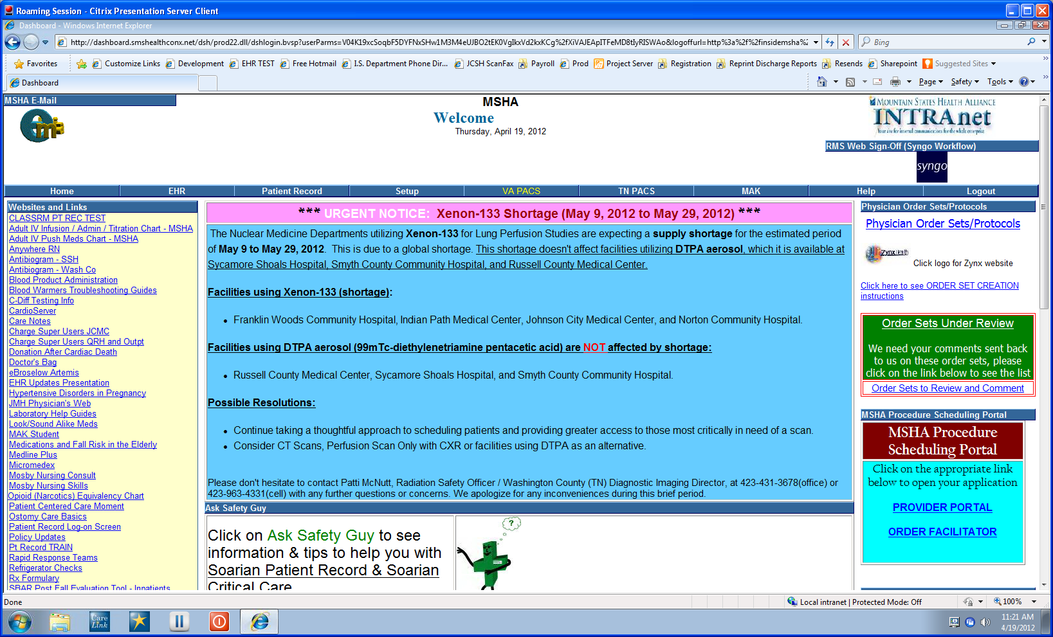
Your CareLink Dashboard will display.
All CareLink applications are available through the Citrix roaming session.

Slide 9
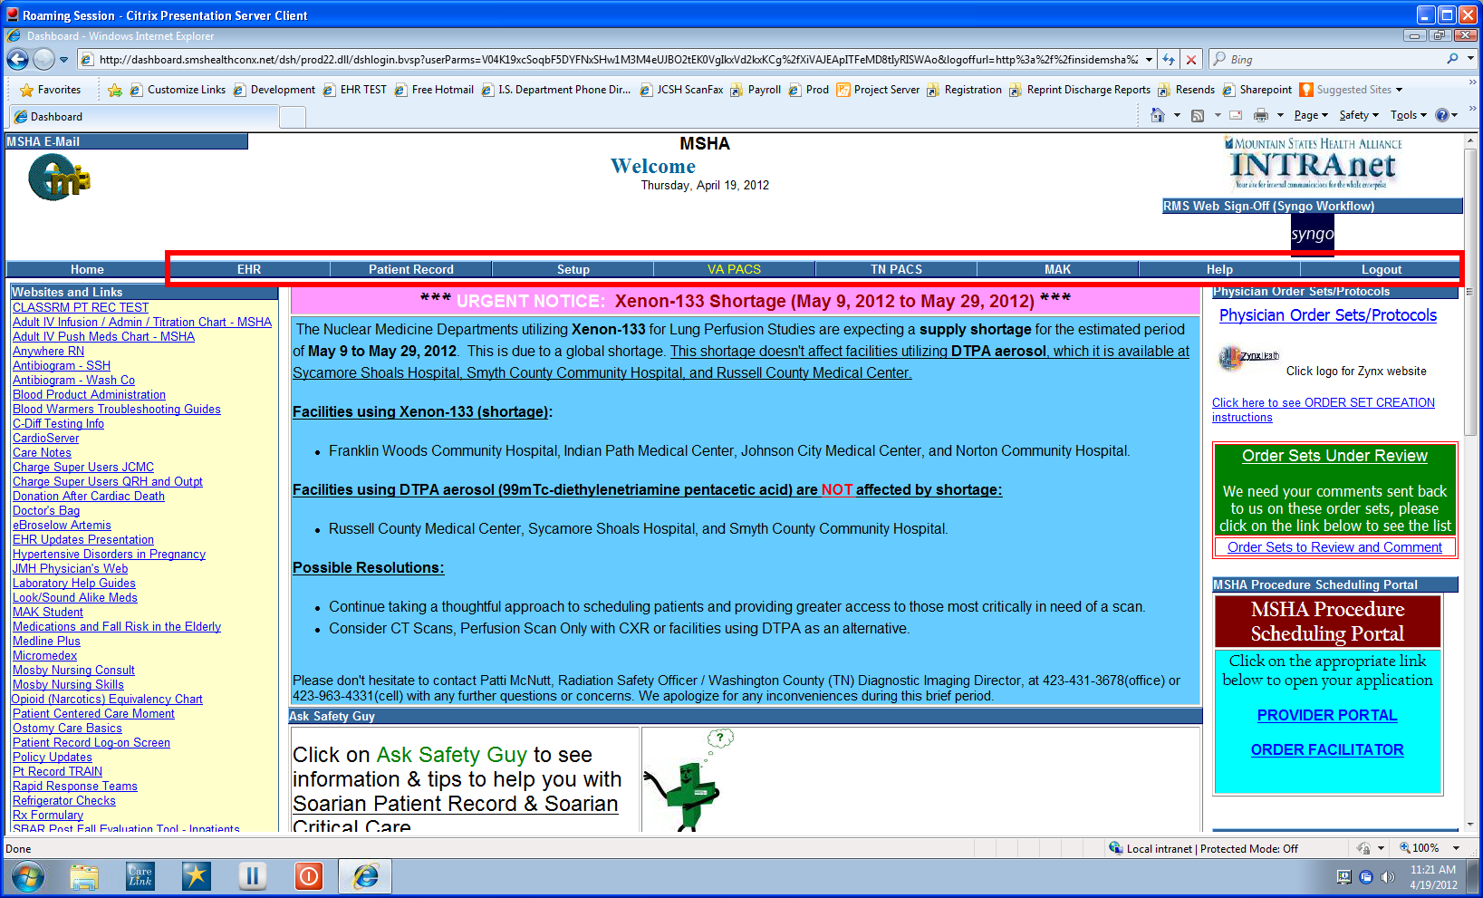
To access CareLink applications (EHR, Patient Record, VA Pacs, MAK) click on one of the links.

Slide 10
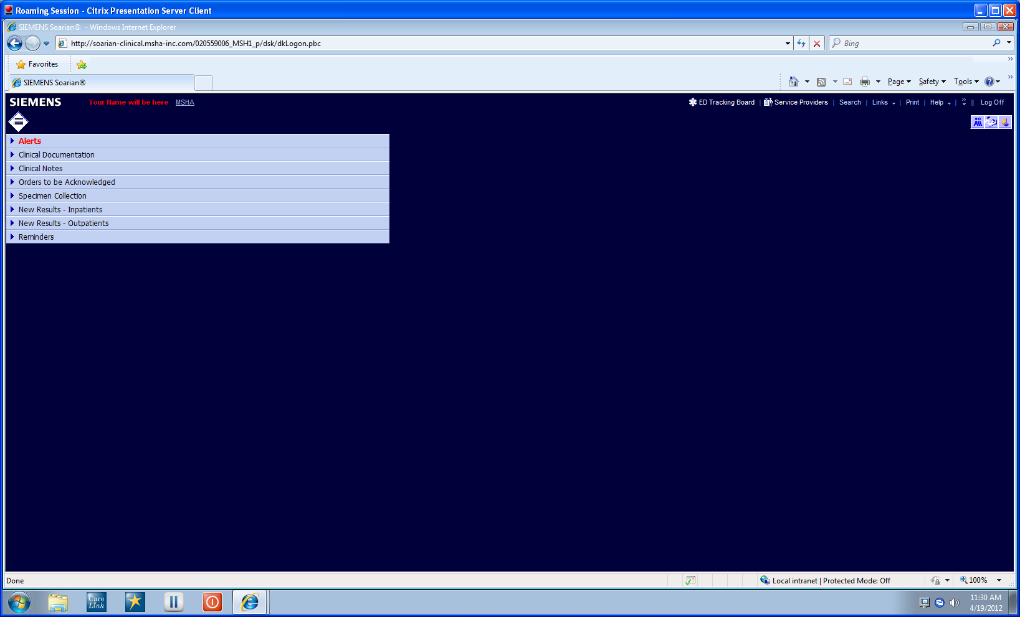
This slide demonstrates Soarian Patient Record.
(**Note it is displayed within the Roaming Session**)

Slide 11
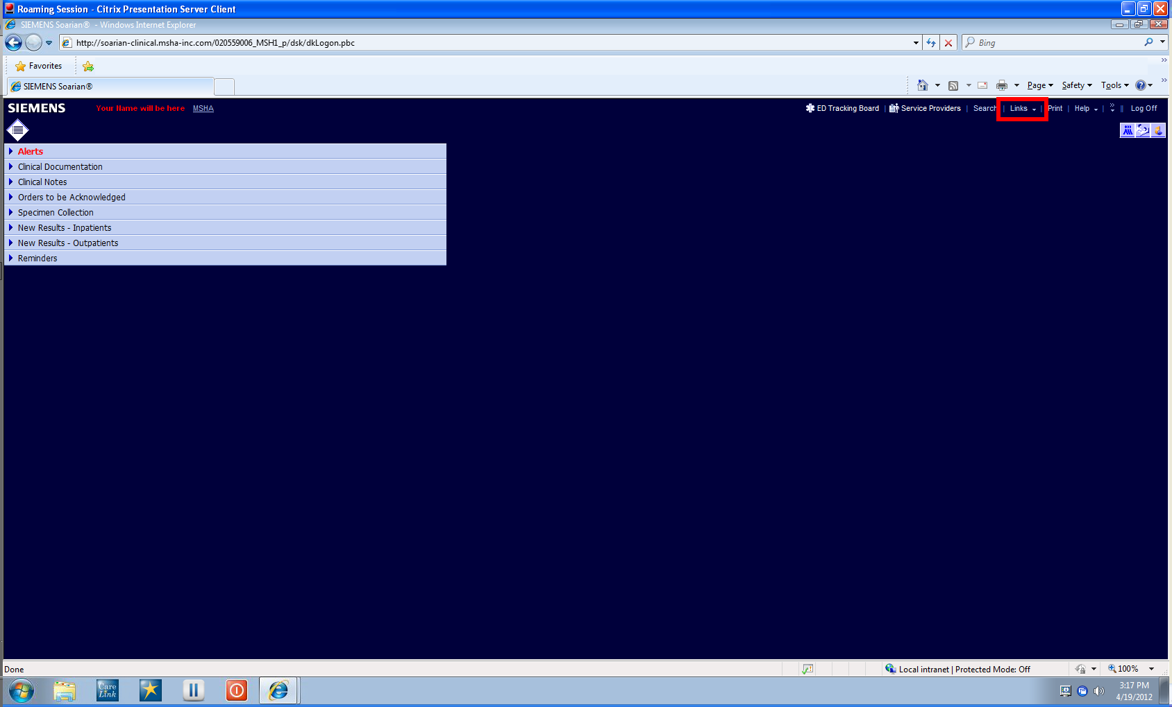
To access Ask Safety Guy, EHR, General Order Sets, Operational Reporting Framework, Reprint Facility and OMS Job Status click where it says Links

Slide 12
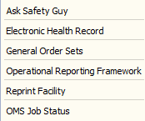
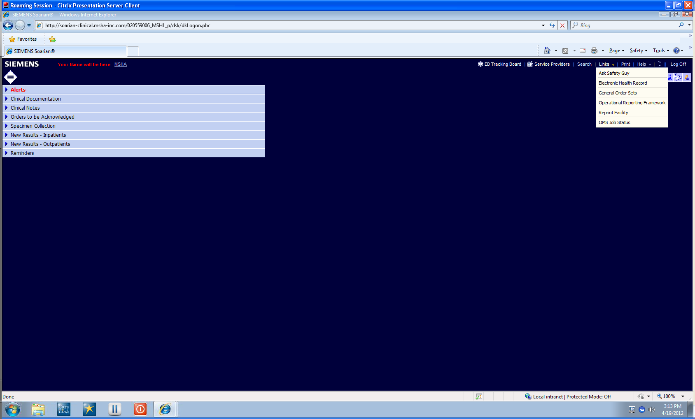
When you click on Links you get a pull down menu with the links to each.
Click on where you would like to go.

Slide 13
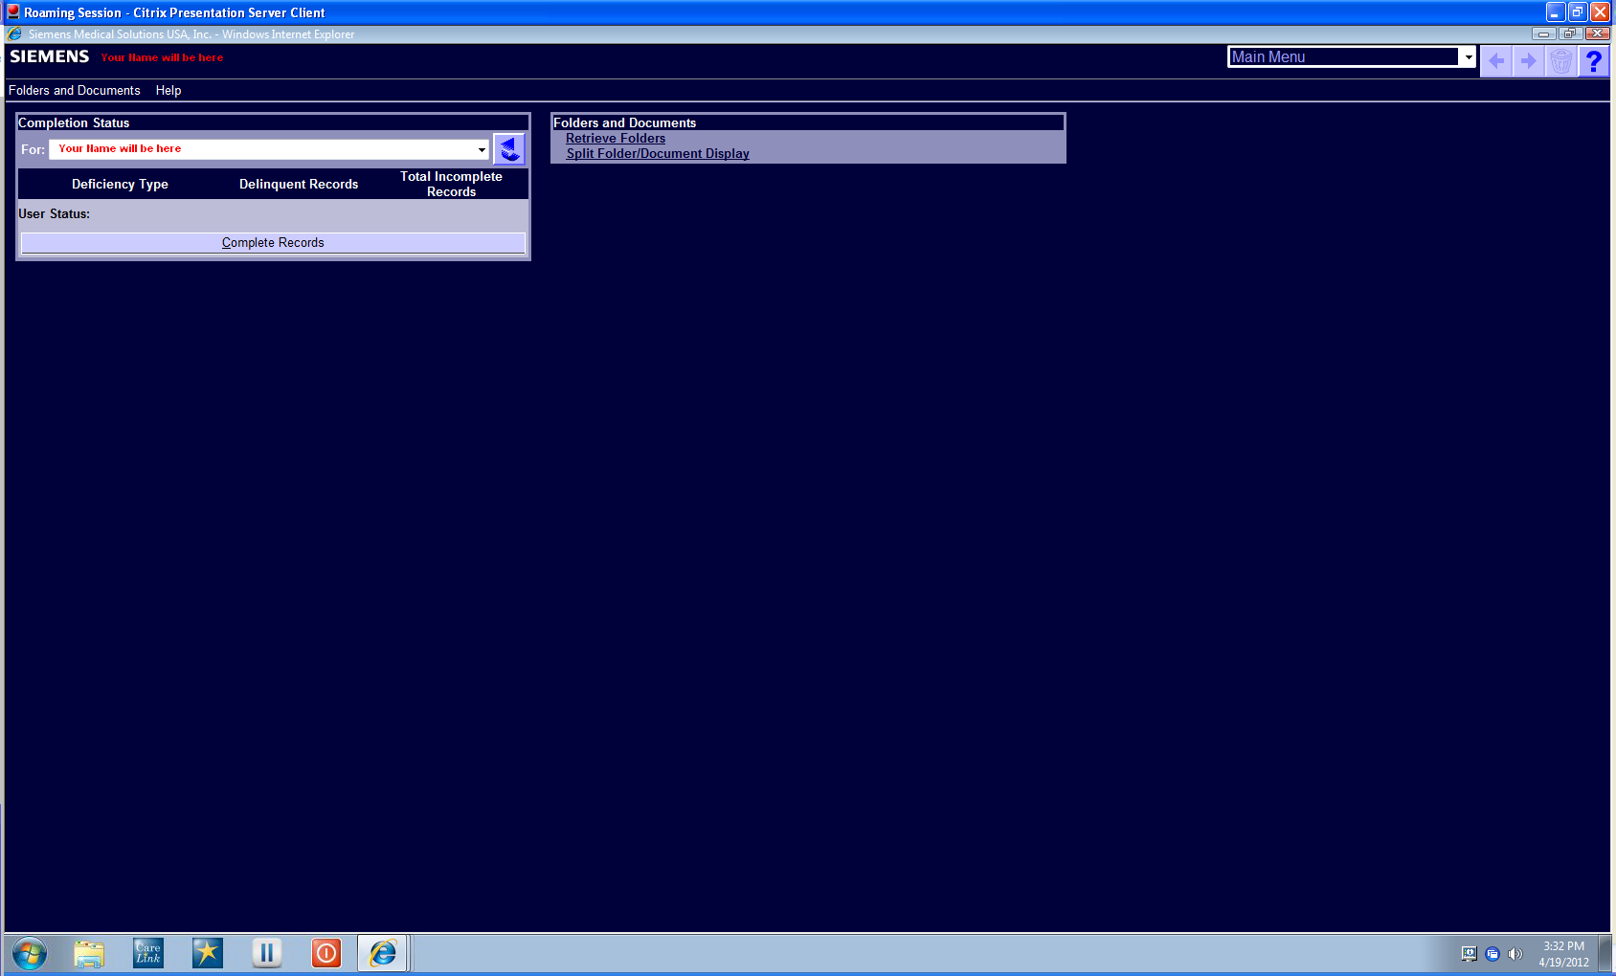
If you click EHR you will be directed here

Slide 14
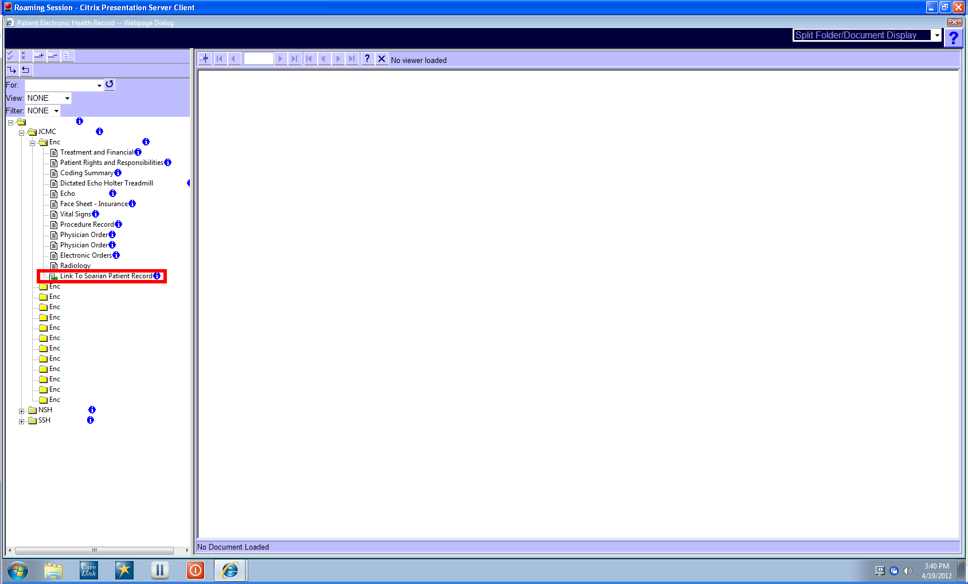
While in EHR if you wish to return to Soarian Patient Record please close out of EHR.
Note: **DO NOT CLICK**
“LINK TO SOARIAN PATIENT RECORD”

Slide 15

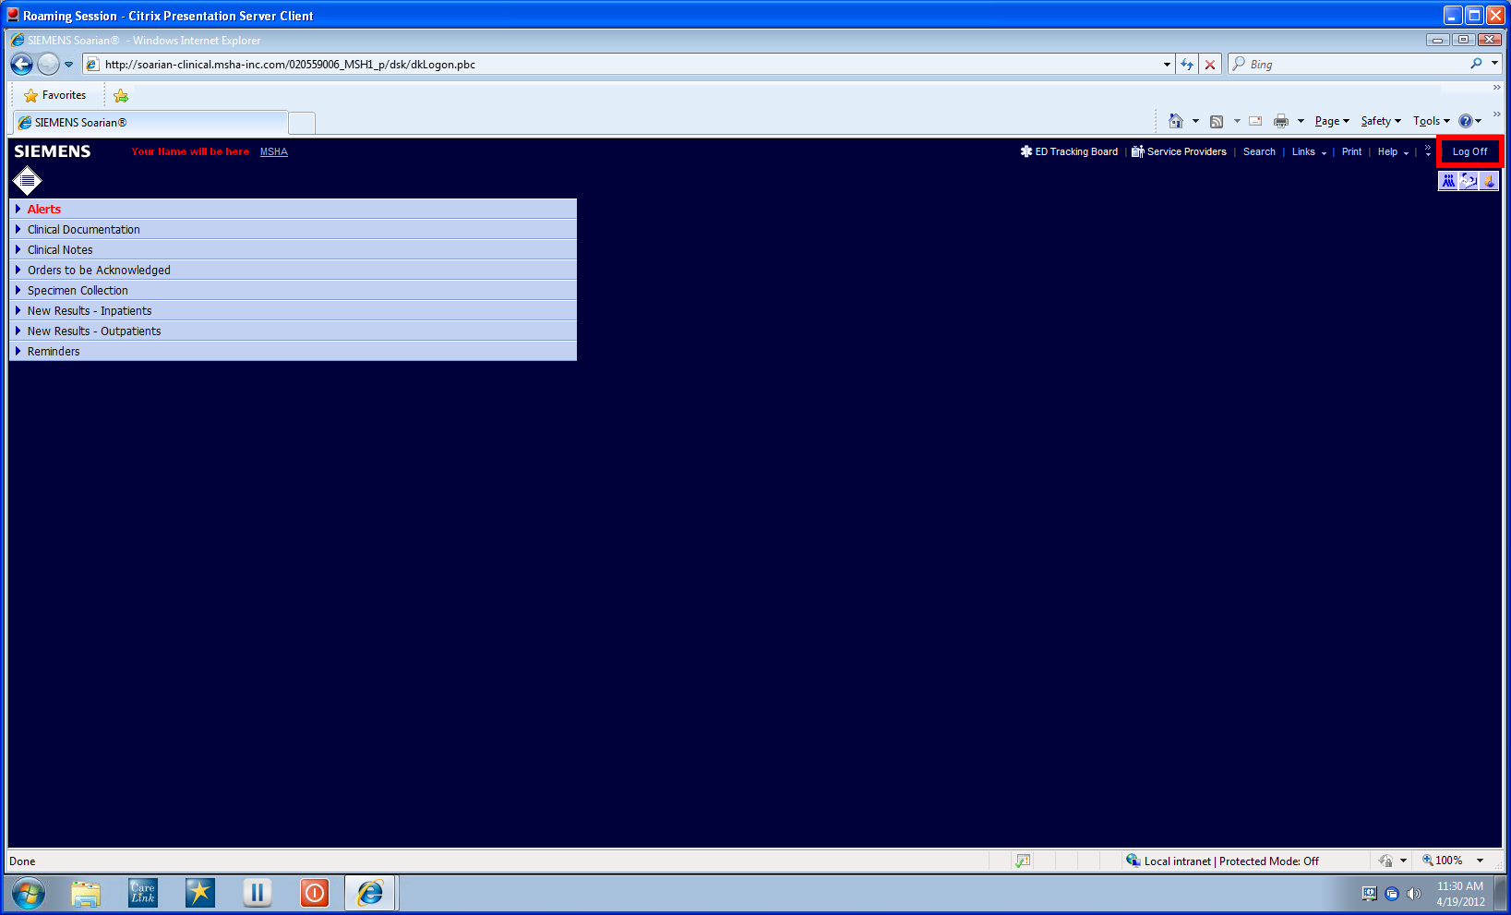
When you are finished in Patient Record
LOG OFF using the Log Off link in the top right corner.

Slide 16

Once you LOG OFF you will be directed back to the
CareLink Dashboard

Slide 17

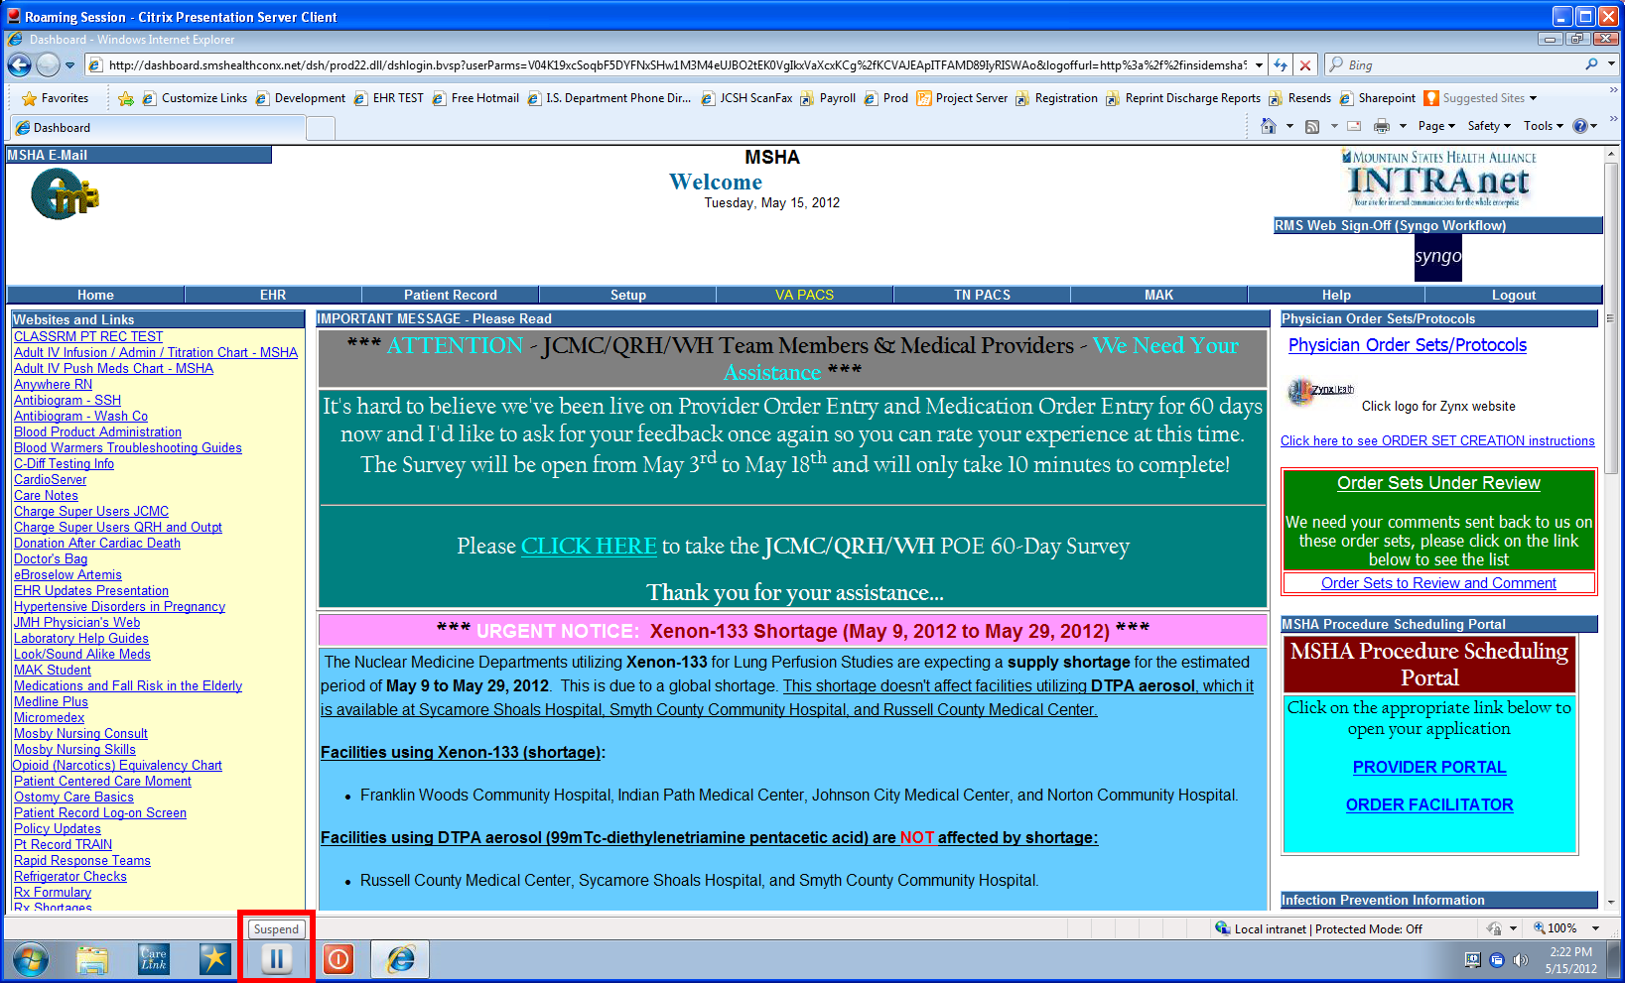
Pause your Roaming Session by clicking on the SUSPEND button. You can then move to a different computer and resume your Roaming Session.

Slide 18

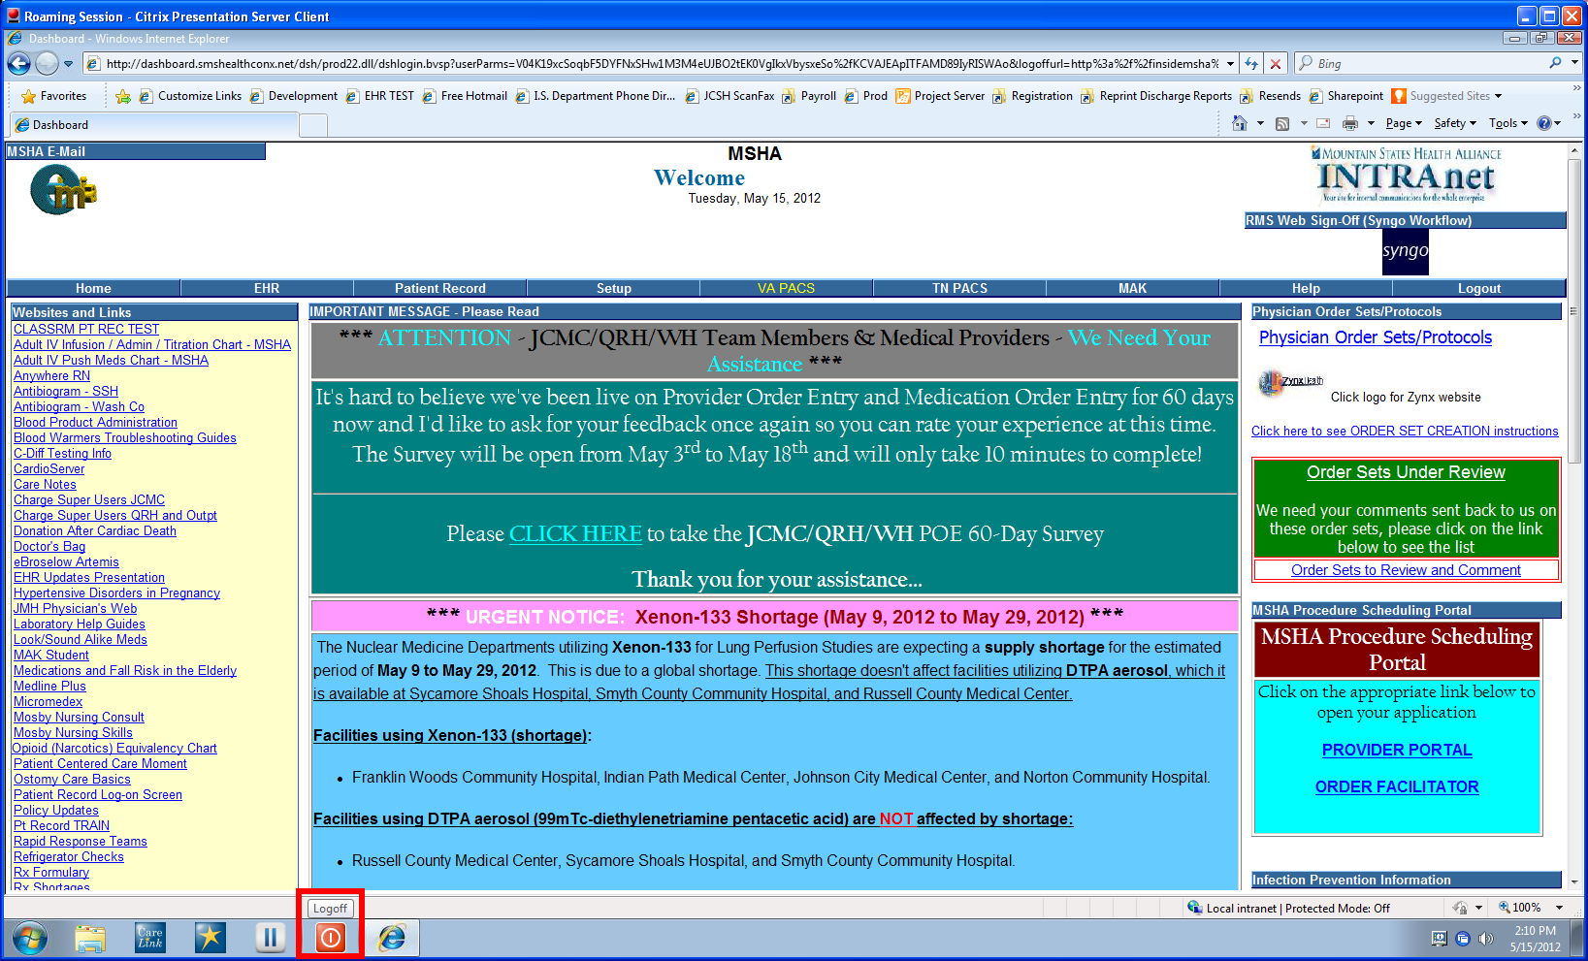
When you click the RED Log Off Button at the bottom of the Roaming Session. This will close your Roaming Session.

Slide 19

Once the Roaming Session is successfully closed you will be back to your Desktop

Slide 20
To restart the Roaming Session at another location you can re-click the myApps Icon and Log back In
*Double Click the myApps Icon*

Slide 21
The Network Login page will display
*Username & Password are required*

Slide 22
The Network Login page will display
*Username & Password are required*

Slide 23
Your Citrix Roaming Session will begin loading

Slide 24
When your Citrix Roaming Session is loading it will also load your User Profile

Slide 25
Your Roaming Session will load and there will be a CareLink Icon on the desktop. Double click the CareLink Icon to load your Dashboard

Slide 26

Your CareLink Dashboard will display.
All CareLink applications are available through the Citrix roaming session.

Slide 27

To access CareLink applications (EHR, Patient Record, VA Pacs, MAK) please click on one of the links.

Slide 28
This slide demonstrates Soarian Patient Record.
(**Note it is displayed within the Roaming Session**)

Slide 29
Why do you want to use
Remote Citrix Server access?
When using the Remote Citrix Server all applications are run remotely from the MSHA data center.
Disabling Pop-up blockers or adding special applications i.e. Java, ActiveX, etc. are not required.
Currently the only way to remotely view PACs and e-MAR is through the Citrix Server.

Slide 30

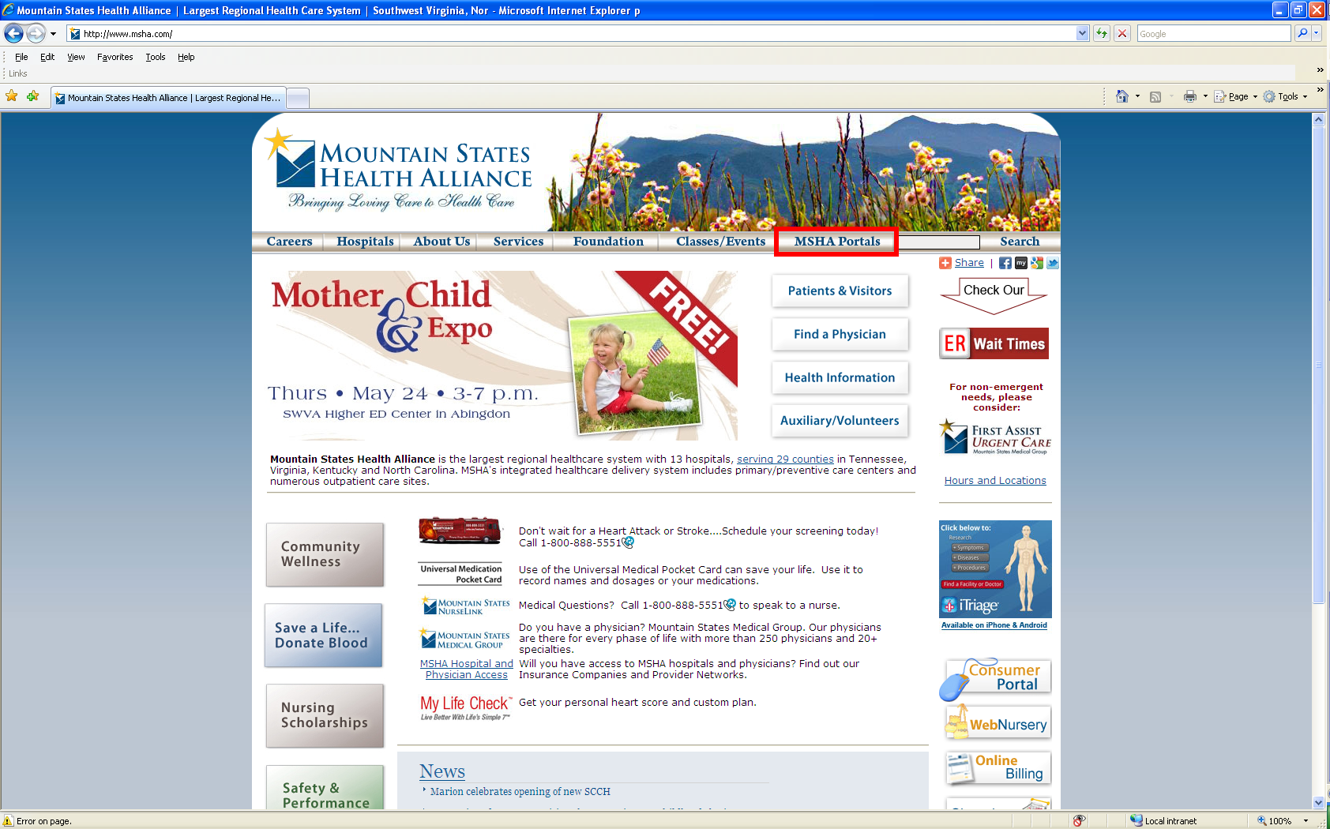
Using any computer with the Internet
Go to www.msha.com
Click on MSHA portals

Slide 31
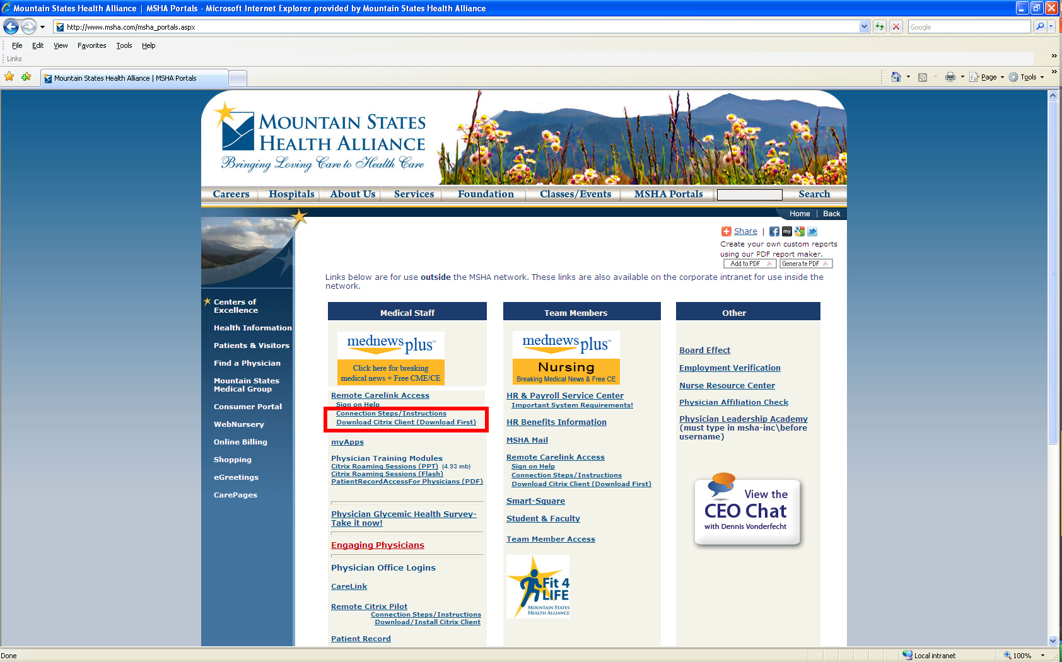
Click on connection steps for initial use to download the Citrix Client.
(**This only has to be done one time**)

Slide 32
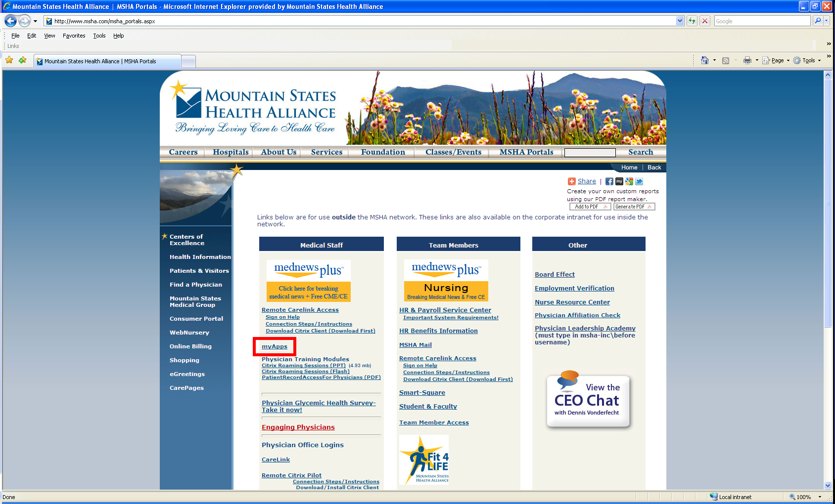
Click on myApps

Slide 33
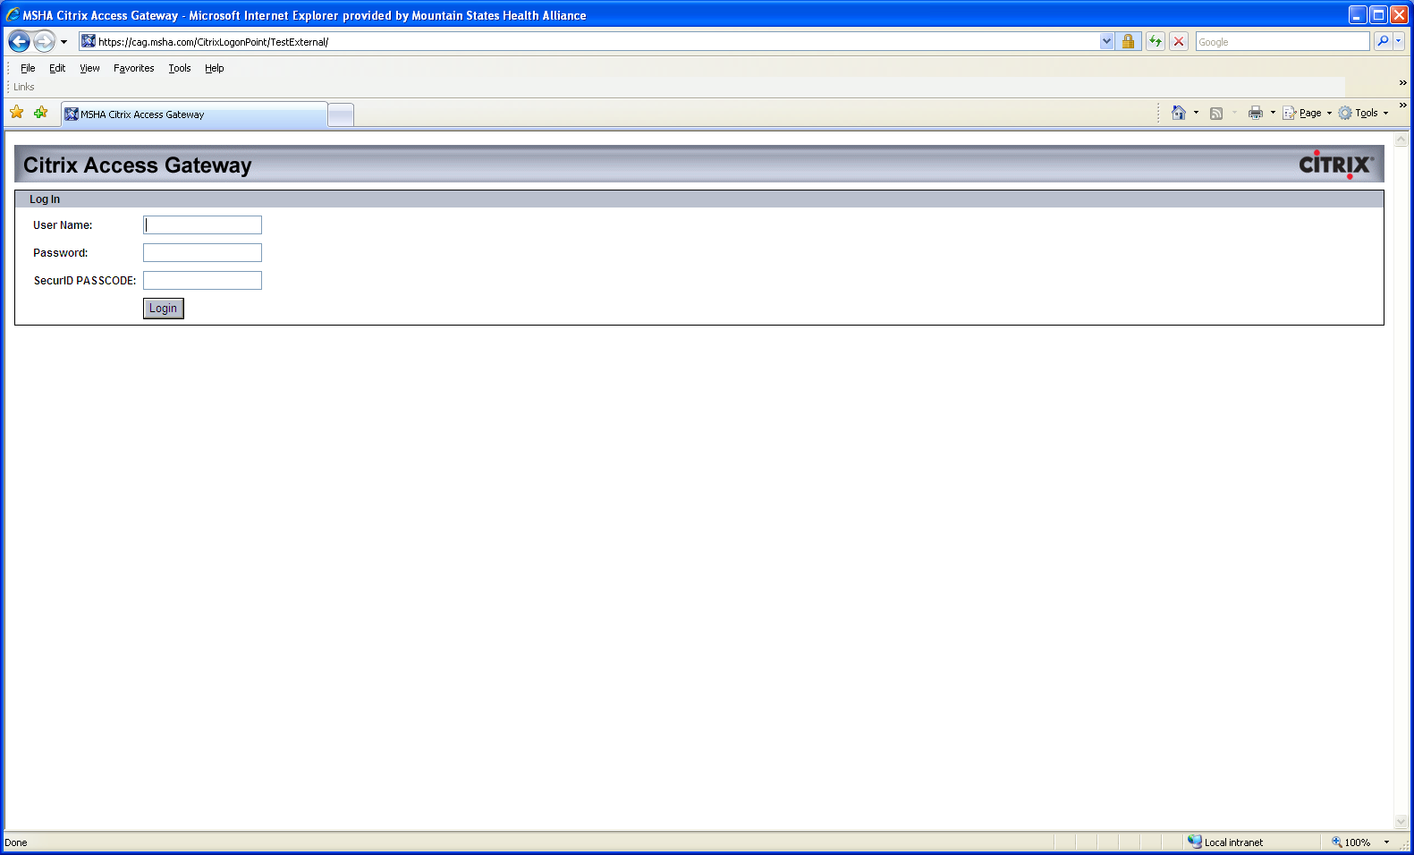
Logon using your Username, Password and Token # before entering the token # you have to enter your 4 digit PIN

Slide 34
Your Citrix Roaming Session will begin loading

Slide 35

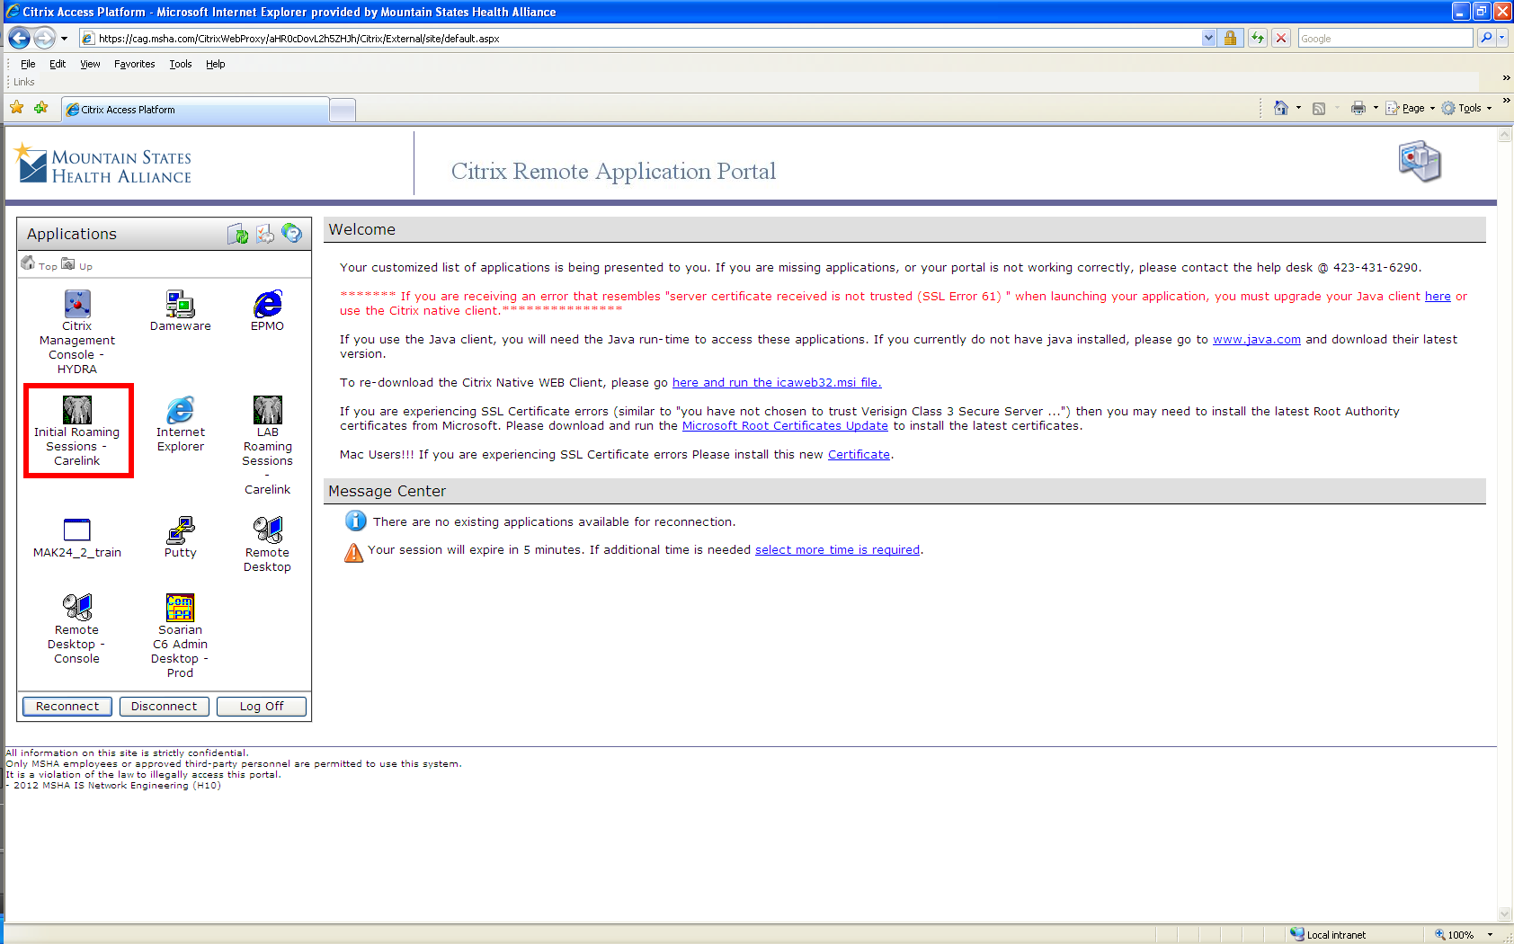
Click on the Roaming Session
CareLink Icon

Slide 36
Your CareLink Dashboard will display.
All CareLink applications are available through the Citrix roaming session.

