Slide 1
Marathon Childbirth Class

Slide 2
What can YOU do to be healthy?
Doctor’s appointments
Either in-person or virtually, depending on your pregnancy and physicians
Exercise
Can continue your normal routine
Diet
Healthy diet = healthy weight gain
A pregnant woman needs about 300 extra calories per day.
Ensure you are getting the “right” extra calories.

Slide 3
When to contact your healthcare provider
Abdominal pain
Intermittent or constant
Vaginal bleeding
If it is a large amount, go directly to the nearest hospital.
Some women experience spotting, especially after intercourse or after having their cervix check, which is normal.
Fever
Greater than 100.4

Slide 4
When to contact your healthcare provider
Changes in your baby’s movements
Headache or visual changes
Vomiting or diarrhea that lasts longer than 24 hours

Slide 5
Preterm labor
Labor that occurs prior to 37 weeks
Possible signs and symptoms can include:
Back pain
Increase in vaginal discharge
Leaking of fluid
Lower abdominal cramping or contractions
Vaginal bleeding

Slide 6
Preeclampsia
Increase in blood pressure and presence of proteinuria during pregnancy
Signs and symptoms can include:
Headache that doesn’t go away with medication, or frequent headaches
Pain in the upper-right side of your abdomen
Sudden increase in swelling
Visual changes (blurry vision or double vision)
Preeclampsia can occur anytime after 20 weeks

Slide 7
Labor
Can come on suddenly or over time
Some women might be fine one minute, and then begin contracting regularly; others might begin contracting irregularly, then more regularly and more intensely and be in labor.
Some women’s water breaks, and they aren’t having contractions at all.

Slide 8
True labor vs. false labor
True labor:
Contractions are regular and become more intense over time.
The whole uterus contracts.
With true labor, contractions continue despite rest.
False labor:
Contractions are typically irregular and do not increase in intensity over time.
Typically, only the part of the uterus contracts
With false labor, if the mother rests or lies down, her contractions become more irregular and less intense.

Slide 9
Labor
The only true way to know if you are in labor is with cervical change.
If you are in true labor, the cervix will dilate from closed to 10 centimeters.

Slide 10
Four Ps of labor
Passenger:
The baby
Passageway:
The pelvis
Powers:
Uterus/contractions
Psyche:
The mother’s mental status

Slide 11
Passenger
Ideally, the baby needs to rotate his/her head to get “in position.”
Ideally, the baby should be in the occiput anterior position; however, one can deliver with the baby in the occiput posterior position, but this can cause an increase in back pain while in labor and a longer labor.
The baby has to be head down to deliver vaginally.
occiput anterior
occiput posterior

Slide 12
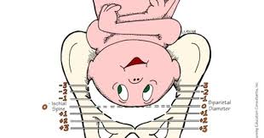
Passageway
Your pelvis is the passageway for your baby to enter this world.
The baby will move “down” in the pelvis throughout labor.
As this occurs, you might feel more pressure due to the head pressing down in the vagina and against the rectum.
When your cervix is checked by a healthcare professional, they will assign a “station.” This is in relation to how low the baby is in the pelvis.
As the baby gets lower and closer to delivery, the numbers are a positive value and the numbers increase in value.

Slide 13
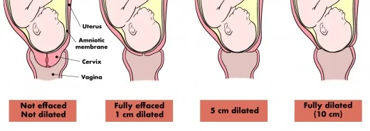
Powers
The contractions caused by your uterus that cause your cervix to open up (dilate) and thin out (effacement)
The cervix must go from closed to 10 centimeters dilated.
The cervix must go from 0% effaced or thick to 100% effaced.
You can see below how the cervix goes from closed to fully dilated and how the cervix also thins out.

Slide 14
Passageway
A fun look at common items and their size in relation to centimeters.
x
Cheerio 1 cm
Slice of Banana 3 cm
Cracker 4 cm
Soda can 7 cm
Bagel 10 cm

Slide 15
Psyche
The mother’s attitude towards labor and her preparation for labor
One’s culture and previous experiences can play a role in this.
Being prepared and more relaxed will help with your attitude toward this experience.

Slide 16
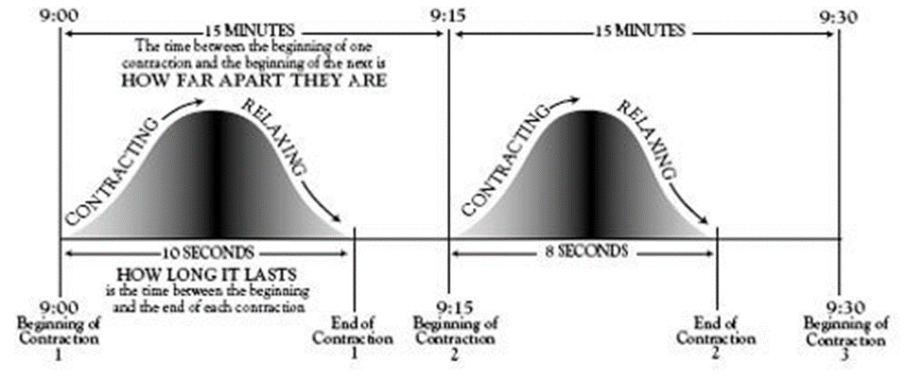
Timing of contractions
Frequency is how often the contractions occur.
When you begin feeling contractions, you want to time them from the beginning of one contraction to the beginning of the next one.
Duration is how long the contraction lasts.
Typically, patients are told to come in when contractions are consistently 3-5 minutesapart and last for about 60 seconds.

Slide 17
Bag of water breaking
The bag of water might or might not break on its own.
Some women experience the bag of water breaking without contractions, while others might have contractions when the bag of waters breaks.
You might experience a large gush of fluid, a constant trickle or the feeling that your pants are constantly damp.
Remember COAT:
C = Color of the fluid
O = Odor of the fluid
A = Amount of fluid
T = What time you noticed the fluid

Slide 18
When to go to the hospital
Contractions that are:
5-1-1: every five minutes, that last for one minute, for one hour
Some patients might need to go to the hospital sooner especially if they experience:
Intense pain that can’t be handled at home, despite contractions being further apart
Leaking of fluid
Vaginal bleeding
Decrease in fetal movements
Rectal pressure
Live far from the hospital
History of fast labors

Slide 19
When to go to the hospital
If you are not having contractions, but you experience:
Leaking of fluid
Vaginal bleeding
Decrease in fetal movements

Slide 20
What to pack
Cameras – extra batteries, chargers
Cell phone and chargers
Socks/slippers
Chapstick
Change/money for snacks for support person
Music for labor/relaxation, any other methods for relaxation
Pillows
Toiletries – shampoo, conditioner, deodorant, toothbrush, toothpaste
Comfortable clothes, robe, pajamas, slippers, bra (breastfeeding), clothes to go home in
Clothes for support person
Breast pads
Car seat – necessary for baby to be discharged
Sleepers, gowns, socks, hand mitts
Outfit for baby to wear home
Baby book

Slide 21
Pushing
Pushing can last from a few contractions up to three hours for a first-time mom.
There is no way to tell how long you will need to push.

Slide 22
Delivery
When the infant’s head delivers, you might be told to stop pushing so the mouth and nose can be suctioned, or you might need to continue to push to deliver the rest of the baby
The baby will be placed directly on your abdomen, and delayed cord clamping be done.

Slide 23
Placenta
The placenta detaches itself from the wall of the uterus anywhere from 5-30 minutes after delivery.
You might feel some cramping while this is occurring.
You might also be guided to give a small push to aid in its delivery.
Your healthcare provider will examine the placenta afterwards to ensure it is intact and all the pieces are present.

Slide 24
Recovery for Mom
After the delivery of the placenta, you and your baby will enter into a recovery phase
Your blood pressure, uterus and bleeding will be checked by the nurse every 15 mins for about 2 hours
It is important to ensure that your uterus continues to contract and shrink and that your bleeding is well controlled

Slide 25
Recovery for Baby
A nurse will be keeping a close watch on your baby for the first few hours after delivery.
The infant’s heart rate, respiratory rate, and temperature will be taken every 30 mins for about 2 hours
It is very important to keep the infant skin to skin during the first few hours after birth and to attempt to breastfeed during this time

Slide 26
Skin to skin for baby
Keeping the infant skin to skin helps the infant:
Regulate temperature, heart rate and respiratory rate
Regulate blood sugar levels
Breastfeed
Bond and transition to life outside the uterus
Your baby should remain skin to skin for a minimum of 1 hour or until the first successful breastfeeding as long as there are no complications for mom or baby

Slide 27
Pain management
Options:
Breathing
Relaxation
Massage
Positions
Pain medication
Intrathecal medication (epidural)

Slide 28
Pain management
Breathing:
Breathe in and out of your nose or mouth in a controlled manner
Relaxation:
Controlling your environment can help you relax
Consider:
Lighting
Sounds
Temperature
Smells
Familiar items from home

Slide 29
Pain management
Massage:
Helps with relaxation
Helps bring oxygen to your muscle
Determine what type of touch feels good to you.
Positions:
Position changes can help with dilatation and help the baby descend
Can help reduce the pain with contractions
Helps mom participate more actively in her labor process

Slide 30
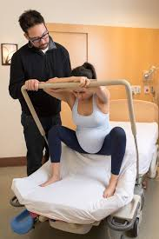
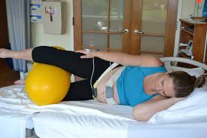
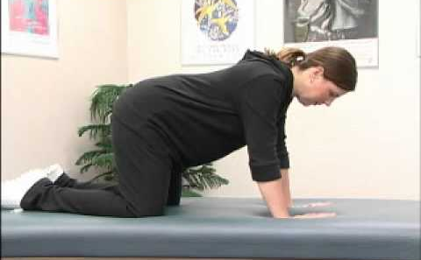
Labor positions
Side Lying (with or without the peanut ball)
Knee-Chest
Squatting

Slide 31
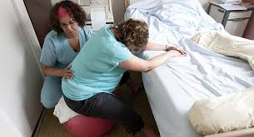
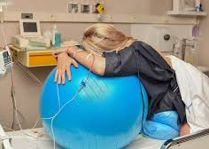
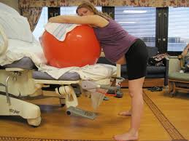
Labor positions using birthing ball

Slide 32
Pain management
Different methods work differently for each person and depending on:
What stage of labor the mother is in
The mother’s pain tolerance

Slide 33
Epidural
Offers pain relief through a small catheter placed in the epidural space
Administered by a CRNA or anesthesiologist
Regional anesthetic that numbs sensations in the lower part of the body
Might still feel pressure with contractions, especially as the cervix dilates completely
Consult will be done on admission by a CRNA/anesthesiologist to discuss risks and benefits

Slide 34
Medical procedures
When considering medical procedures, think about the:
Benefits
Alternatives
Risks
Ask questions so you are comfortable with the procedure.
Induction of labor
Fetal monitoring
Artificial rupture of membranes
Forceps/vacuum extraction
Episiotomy

Slide 35
Induction of labor
Reasons for induction:
Mother has passed her due date.
Mother or fetus has a medical reason for delivery.
The water breaks, and labor hasn’t started, at term.
If the mother needs to be induced, cervical ripening might be needed first.
Cervical ripening is done when the cervix is closed or only slightly dilated and thick.

Slide 36
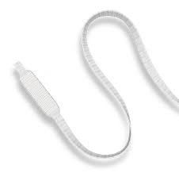
Induction methods
Cervical ripening:
Cervadil:
A medicated string that is placed in the vagina near the cervix
Remains in place for 12 hours, or until active labor begins
Cytotec:
A pill that is placed in the vagina by the cervix
Can be placed every four hours as needed

Slide 37
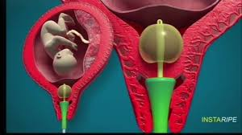
Induction methods
Cervical ripening
Cervical Foley:
A catheter that is placed inside the cervix (typically dilated a little)
The catheter is inflated with fluid to cause pressure and stretching of the cervix.
This mechanically dilates the cervix.

Slide 38
Induction methods
Oxytocin:
Medication that is administered through an IV that causes contractions
Also administered after delivery to cause the uterus to contract and shrink
The medication is increased based on your body’s response to it.
Once your body is contracting regularly and having cervical change, the medication will no longer be increased.

Slide 39
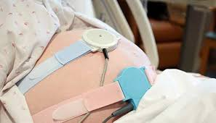
Fetal monitoring
External:
Monitors are placed on the mother’s abdomen to monitor the baby’s heart rate and the mother’s contractions.
Allows the healthcare team to know how the baby is reacting to labor

Slide 40
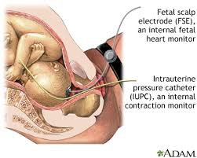
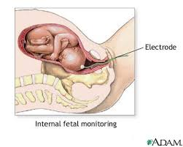
Fetal monitoring
Internal:
More invasive way to monitor the baby’s heart rate and mother’s contractions
Might be done if the healthcare team is unable or having difficulty tracing the fetal heart rate and/or contractions
IUPC is used to monitor contractions
FSE is used to monitor the baby’s heart rate
The baby might have a small spot on the top of his/her head from where this is placed, but it shouldn’t cause any long-term problems.
IUPC
FSE

Slide 41
Artificial rupture of membranes
Is done using an amnio hook when your water doesn’t break on its own
May be done to help facilitate labor or when the cervix is completely dilated, and delivery needs to occur

Slide 42
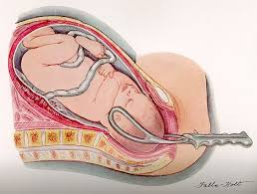
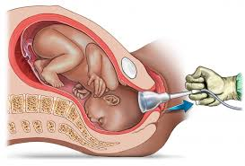
Forceps/vacuum extraction
Forceps:
Placed on the sides of the baby’s head to aid in delivery of the head
Vacuum:
A cup that is placed on infant’s head to aid in the delivery of the head
The cup “suctions” to the head

Slide 43
Forceps/vacuum extraction
Risks:
Bruising
Nerve problems on the face (forceps)
Bleeding in the fetal head (vacuum)
Unsuccessful, and a Cesarean section would be required

Slide 44
Episiotomy
No longer routinely done
Done only in a case where the fetus needs to be delivered more quickly
Consists of cutting the maternal perineum to allow more space for the delivery of the baby
Most physicians allow the maternal skin to stretch and tear on its own, rather than cut an episiotomy.
Tears heal better and are typically not as bad than if an episiotomy had been cut.
If an episiotomy had been cut, the maternal skin could tear further.

Slide 45
Medical procedures
All medical procedures have risks associated with them.
Your healthcare professional should review the risks and benefits with you prior to performing any medical procedures on your or your baby.
Make sure to ask questions and fully understand prior to consenting to a procedure you are unsure about.

Slide 46
Cesarean birth
Surgical delivery of the baby through an incision made on the lower abdomen
Performed if a vaginal birth isn’t possible for mom or baby

Slide 47
Reasons for a Cesarean birth
Planned
Breech (butt first) presentation
Transverse (baby lying sideways) presentation
Placenta previa (placenta low or covering the cervix)
Multiple gestation (more than one baby)
Previous Cesarean birth
Medical condition in mom or baby
A planned Cesarean section will typically be done under spinal anesthesia.
Transverse
Anterior
Breech

Slide 48
Reasons for a Cesarean birth
Unplanned
Abnormal fetal heart rate
Labor is not progressing (cervix isn’t dilating, despite adequate contractions)
Mother has pushed for three hours, and infant is not close to delivery
A unplanned Cesarean section will typically be done under an epidural or spinal anesthesia.
If the you have an epidural in place prior to the Cesarean section, you will be given a bolus dose to increase the numbing effect of the epidural.

Slide 49
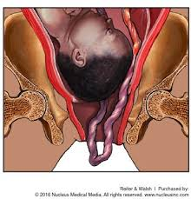
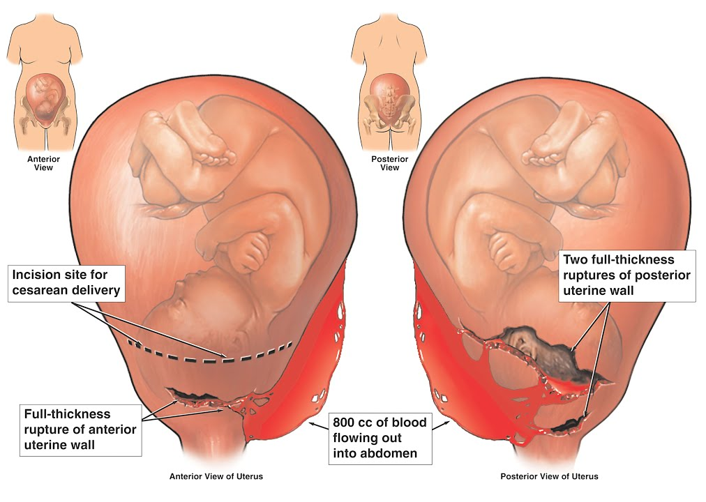
Reasons for a Cesarean birth
Emergency
Cord prolapse (umbilical cord is in front of the baby’s head)
Placental abruption (the placenta begins tearing away from the uterine wall)
Fetal distress (low fetal heart rate that warrants emergency birth)
Uterine rupture (uterus tears open, typically only happens with a previous uterine scar)
An emergency Cesarean birth will be done under general anesthesia.

Slide 50
Cesarean birth
You will still be able to hold your infant skin-to-skin.
This can be done while you are in the operating room
If you don’t feel up to doing skin-to-skin in the operating room, we encourage the father to do skin-to-skin.
Some mothers breastfeed while they remain in the operating room and the surgery is being finished.

Slide 51
Routine care of the newborn
Skin-to-skin
Breastfeed
Vital signs
Assessment
Weight/length
ID bands
HUGS tag
Erythromycin/vitamin K/ hepatitis B vaccine
A consent will be obtained for the hepatitis B vaccine.
If you decline the erythromycin or vitamin K, a refusal form will need to be signed.

Slide 52
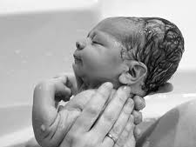
Physical characteristics of the newborn
Molding
Your infant’s head might be coned-shaped from the birth canal.
This is normal and will last a few days to a week.
Vernix
White, thick covering on the infant’s skin
This is normal and was protecting the skin while in utero
Milia
White bumps on the infant’s nose and face

Slide 53
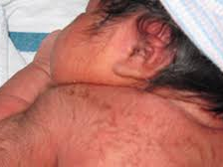
Physical characteristics of the newborn
Lanugo
Hair that covers some newborns
More often seen in preterm infants, as this hair goes away/thins around the eighth month of pregnancy
Newborn rash/acne
Red bumps on the infant’s face
Can last for several weeks or months
Hands and feet
Newborns’ hands and feet are often blue for the first couple of days after delivery.
This is called acrocyanosis and is normal.

Slide 54
Breastfeeding
Babies:
Fewer infections, including ear infections
Lower risk of eczema
Lower risk of childhood obesity
Lower risk of Sudden Infant Death Syndrome (SIDS)
Improved brain development
Mother
Decreased risk of breast and ovarian cancer
Decreased postpartum depression
Decreased risk of Type 2 diabetes
Increased weight loss after pregnancy
Better mother/baby sleep cycles

Slide 55
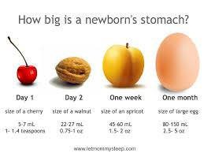
First feeding
Your first milk is called colostrum.
The first feed should occur within the first 60 minutes of life.
If this doesn’t occur, continue to hold your baby skin-to-skin until after that first feeding occurs.

Slide 56
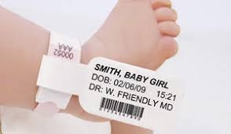
Infant security and identification
At delivery, your infant will be given four bands:
Two are identification bands that match the adult bands
These bands are placed on an arm and leg of the infant, and two adults are also banded in the delivery room.
This is to ensure you are always given the correct infant.
One band is the “regular” hospital ID band, similar to the mother’s, with a barcode for medication administration.

Slide 57
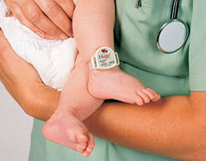
Infant security and identification
The last one is a HUGS tag.
This is to ensure the infant remains on the hospital unit at all times
If the tag gets near any of the exit doors, an alarm will sound.
An alarm will also sound if the tag is removed prior to being discharged.

Slide 58
Newborn’s 24-hour testing
When your infant is 24 hours old, they require certain state-mandated tests. These include:
Newborn screening
Critical congenital heart screening
Testing for jaundice

Slide 59
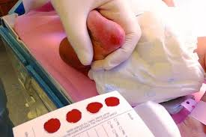
Newborn screening
Involves obtaining a blood sample from your baby’s heel
The heel is “pricked,” and five-seven drops of blood are placed on the newborn screening form.
Tests for several metabolic disorders that might not show symptoms, but need immediate attention
You will get results from the tests in about two weeks from the state.
If the results come back for a disorder, the test will need to be repeated to confirm.

Slide 60
Critical Congenital Heart Screening (CCHD)
Done to detect any potential heart defects that might have been missed on ultrasound
Done by placing a pulse ox around the infant’s foot to measure the amount of oxygen in the baby’s blood
If the infant doesn’t pass with the monitor on the foot, the monitor will be placed on the infant’s hand.
This test can be repeated later if the infant doesn’t pass.

Slide 61
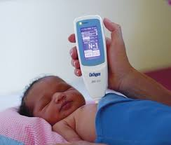
Jaundice
Your infant will be tested for jaundice at 24 hours of age, on the day of discharge and as needed for increasing “yellow” color of the skin.
The test is done by placing a bilimeter on the breastbone of the infant.
This is done three times, then the reading is displayed.
If the reading is high, a blood sample will be obtained to confirm the level.

Slide 62
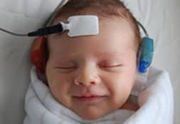
Hearing screen
A hearing screen will be done on your baby prior to discharge.
This test is done by placing “headphones” over your baby’s ears, as well as three other electrodes.
If your baby doesn’t pass the first time, the test will be repeated prior to discharge.
Some infants do not pass the initial screening because of fluid in their ears.

Slide 63
Circumcision
An elective medical procedure done on male infants to remove the foreskin around the penis
AAP believes circumcision has potential medical benefits and advantages, as well as risk.
Current evidence indicates the procedure’s benefits outweigh the risks.
Not essential to child’s overall wellbeing – the decision is up to the parents after consulting with their pediatrician
If the parents elect to have their infant circumcised, it is typically done on the day of discharge.

Slide 64
Discharge
You and your baby will be required to stay for 24 hours after delivery.
If you have had a vaginal delivery, and you and your baby are stable after 24 hours, you might be discharged.
If you have had a Cesarean birth and are stable on Day Two after delivery, then you might be discharged.
If you deliver in the evening or later, you might stay until the next day, despite being 24 hours post delivery.

Slide 65
Discharge
You will receive discharge instructions for you and your baby.
You and your baby will need to make follow-up appointments with your healthcare team.
Your baby will most likely need to be seen the day after you are discharged at the pediatrician’s office.
All moms are screened for postpartum depression prior to discharge.

Slide 66
Postpartum depression
Different than the “baby blues”
Most women are emotional after delivery. However, if you have:
Crying spells that seem excessive
Irritability
Thoughts of harming yourself or others
Disinterest in your baby or activities
Feeling of hopelessness or loneliness
Feeling nervous or worrying excessively

Slide 67
Postpartum depression
Postpartum depression is treatable.
Treatments could include:
Medications
Counseling/therapy
It is crucial to take care of yourself to help prevent and/or help with symptoms of postpartum depression.
SLEEP is important for you and baby.
Sleep when baby sleeps.
Have someone sit with your baby so you can sleep.

Slide 68
Postpartum depression
Make sure to take some “ME” time.
Make sure to have time together as a couple!
Utilize your support system.
Let people help you.
And remember…

Slide 69
There is no such thing as a PERFECT PARENT.

Slide 70
Thank you for participating in our Childbirth Classes!
If you have any questions about the material presented, or something that wasn’t presented, please contact:
Laura Hicks
laura.hicks@balladhealth.org
423.431.6183

